Slide 1

Image Forgery Detection and Localization Phase 2- Review 1, Jan 2025
Project Advisor : Dr. R. Aarthi
SL.No | Roll No | Student Name | Section
1 | CB.EN.U4CSE21414 | C.Sahithee Vaibhav | CSE-E
2 | CB.EN.U4CSE21430 | K.Mahammad Sami | CSE-E
3 | CB.EN.U4CSE21440 | N.Ujwal Srimanth varma | CSE-E
4 | CB.EN.U4CSE21467 | Vinayakan VS | CSE-E

Slide 2
GUIDE APPROVAL SCREENSHOT

Slide 3
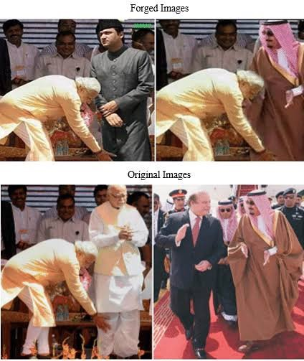
Objective and Problem Statement
To build an AI model for accurate forgery localization in images and documents, addressing critical impacts like misinformation, social harm, and public trust.

Slide 4
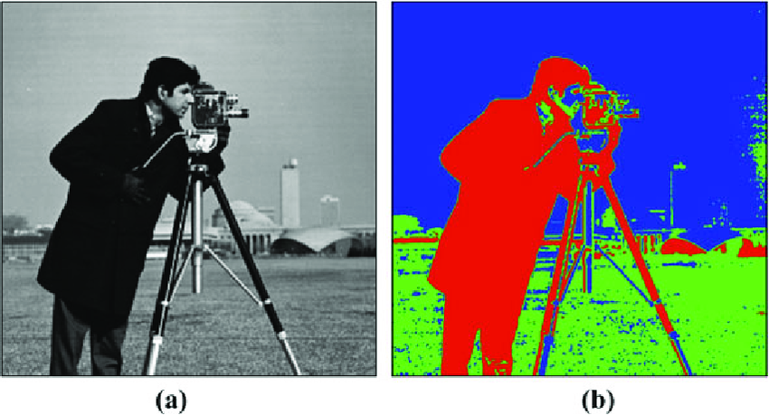
WORK DONE IN PHASE 1 –OVERVIEW
Dataset Preparation
Model Experiments replicating to state of art techniques
UNET model was used
All types of agumentations explored
U-NET

Slide 5
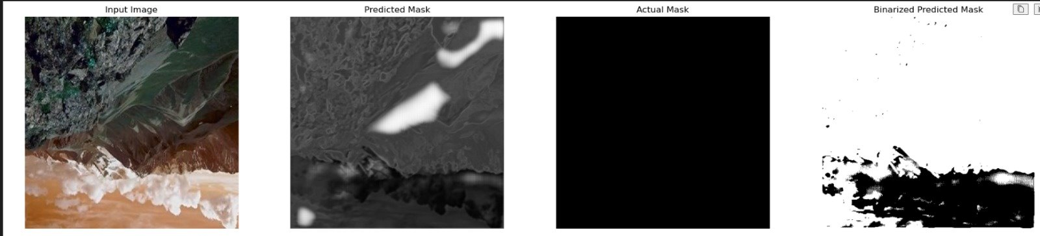
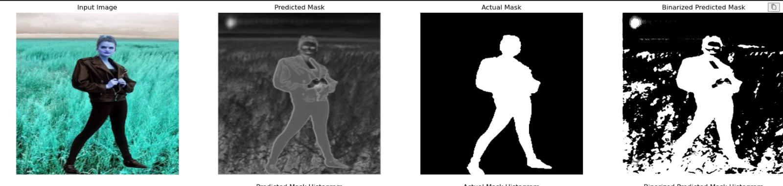
Results From Phase 01

Slide 6
Phase-01 Models perfromance
Model | Accuracy
UNET+Agumentations | 56.87%
UNET without Real images | 63.4%
UNET without agumentations | 88.4%
Conclusions from Phase-01
Accuracy was the main metric used, but alternative metrics should be explored.
Augmentations did not improve performance as expected.
The model performed better without augmentations.
Different preprocessing techniques need to be tried.

Slide 7


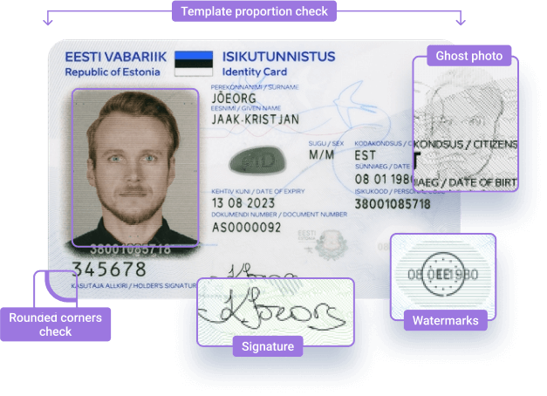
IDENTIFICATION OF RESEARCH GAP
Most existing models struggle with achieving a balance between key metrics in precise localization of forgeries in images.
Limited research has been conducted on detecting forgeries in printed media, leaving a significant gap in addressing this area.

Slide 8
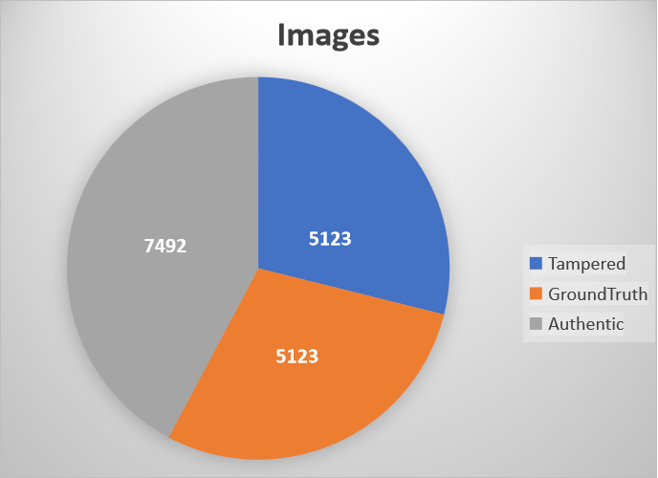
DATASET DETAILS CASIA.V2.0
Au (Authentic): Original, unaltered images.
Tp (Tampered): Images that have undergone some form of manipulation.
Gt (Ground Truth): Binary masks highlighting tampered regions.

Slide 9
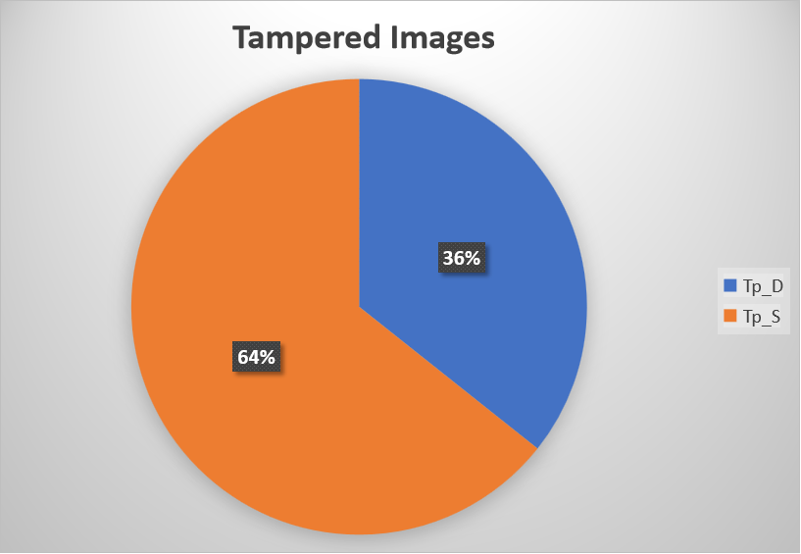
DATASET DETAILS CASIA.2.0
Tp_D: Image splicing tampering (content taken from a different source image).
Tp_S: Copy-move tampering (content copied and moved within the same image).

Slide 10
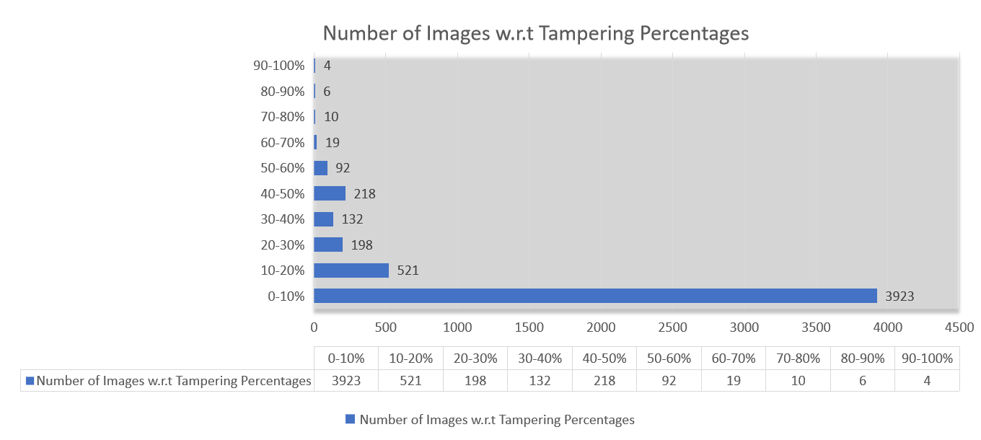
DATASET DETAILS CASIA.V2.0

Slide 11
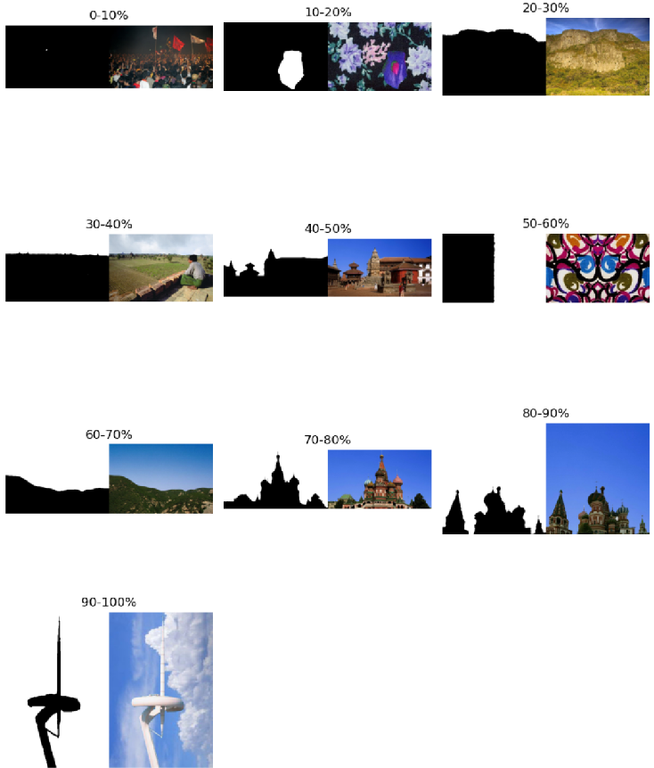
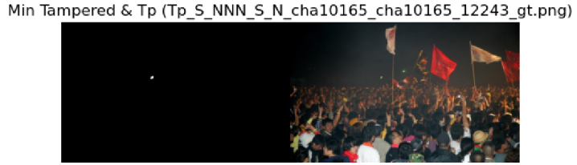
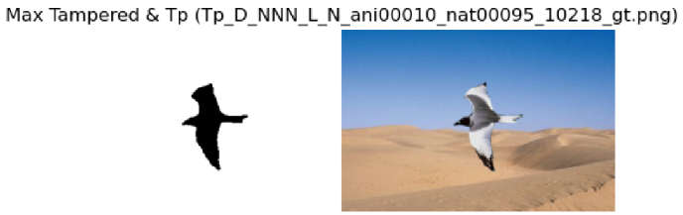
Deep Dive into Dataset
Min tampered percentage: 0.02%
Max tampered percentage: 96.30%

Slide 12
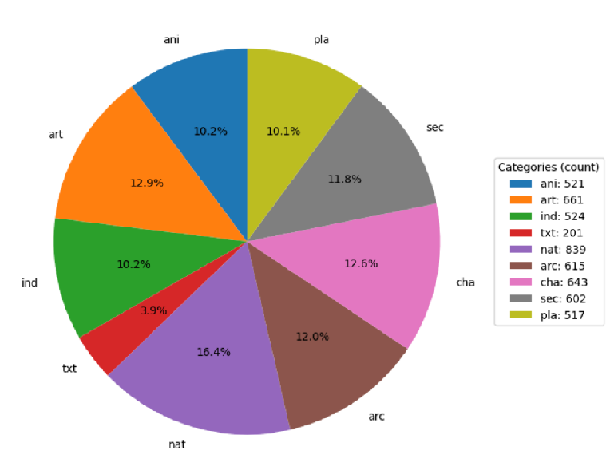
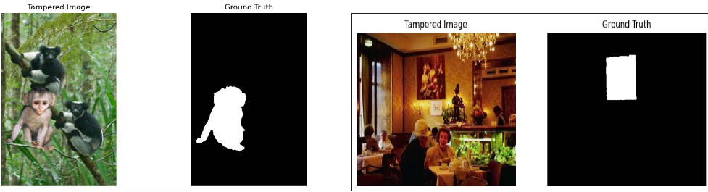
DIFFERENT TYPES OF CATEGORIES IN CASIA DATASET
ani: animal category)
arc: (architecture)
art: (art images)
cha: (characters)
ind: (indoor)
nat:(nature)
pla: (plants)
txt:(texture)

Slide 13
Method Building Process
UNet Coclusion:
Focused on highlighting features but struggled with precise localization in tampered regions.
Transition to CNN Variants:
CNN + ELA: Combined tampered images and ELA images as dual inputs for improved detection.
CNN + ELA + SRM Filters: Added SRM filters as an extra input stream to capture manipulation traces.
CNN + ELA + UNet: Incorporated UNet during the reconstruction phase for enhanced localization.
CNN + ELA (Feature Fusion): Explored various fusion strategies for feature and image integration.
Tried Vision Transformer to explore the nature of transformers for this task

Slide 14
Model 1: ELA-CNN Dual Input Approach
Step-1 : Generating ELA images
Step-2 : Image Resizing
All images are Resized to 128x128.
Step-3 : Image Scaling (/255)
All pixel values are mapped between 0 and 1.
Step-4 : Splitting dataset
Data is split with 80:20 ratio for train and test respectively.

Slide 15
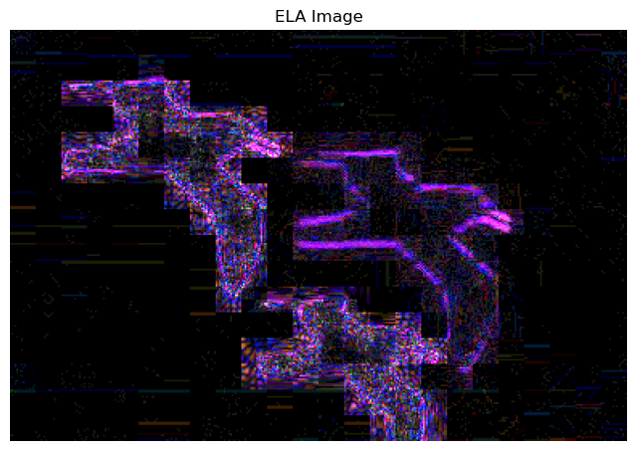

Why ELA with Tampered image?
ELA detects image manipulation by highlighting differences in compression levels, revealing tampered regions with distinct artifacts.
It provides critical evidence of forgery, making invisible manipulations detectable and aiding in identifying edited areas.
Using the tampered image (X1) and the ELA image (X2) together enhances the model's ability to detect and localize forgeries effectively.
X1 provides important visual features, while X2 highlights editing artifacts like compression differences, improving training and localization.
X1(Tampered Image)
X2(ELA Image)
Ground Truth Image

Slide 16
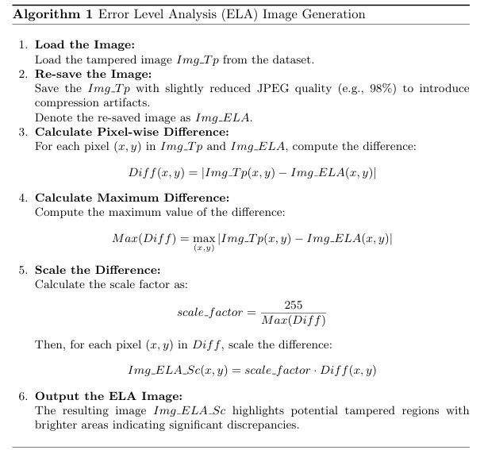
Algorithm For ELA

Slide 17
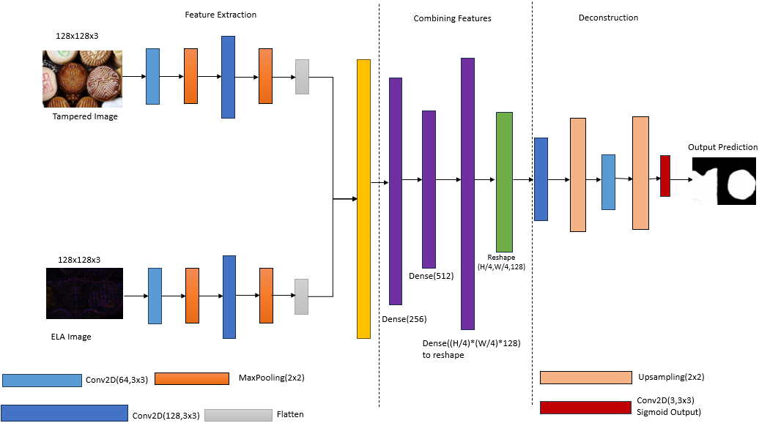
ARCHITECTURE DIAGRAM

Slide 18
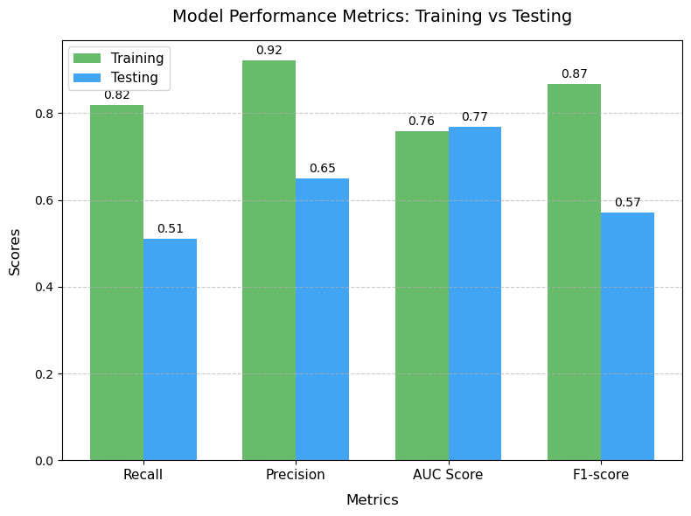
Model Performance

Slide 19
Why F1-Score is a good metric?
Accuracy Limitation:
Black pixels dominate ground truth masks.Predicting all black yields high accuracy but misses tampered regions.
F1-Score Advantages:
Balances Precision and Recall
Precision: Accuracy in predicting non-tampered regions (black pixels, labeled 0).
Recall: Effectiveness in identifying tampered regions (white pixels, labeled 1).
F1-score ensures better evaluation by focusing on both false positives and false negatives.
AUC Score is also considered for comparison as Measures how well the model separates classes (positive vs. negative).
 | Train Data - F (Pred) | Train Data - R (Pred) | Test Data - F (Pred) | Test Data - R (Pred)
F (Act) | 49428117 | 616338 | 11556637 | 689399
R (Act) | 1625380 | 7312565 | 1224817 | 1274747
Confusion Matrix

Slide 20
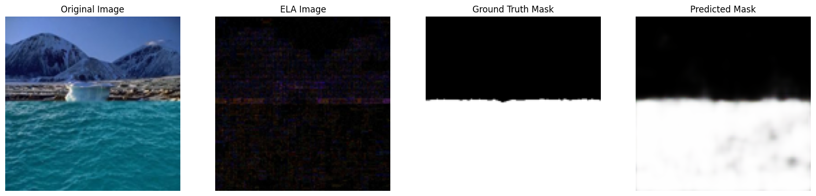
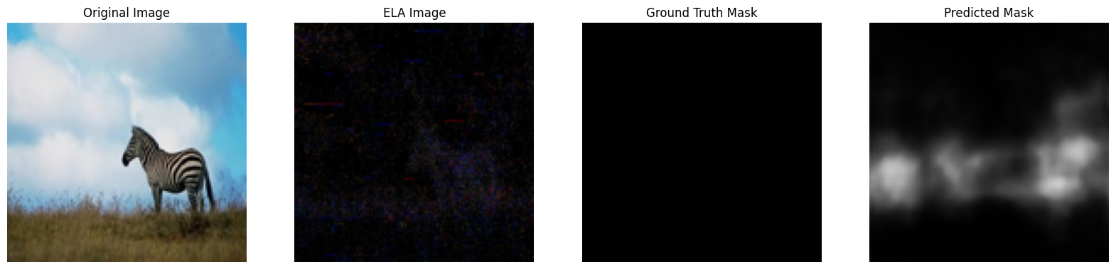
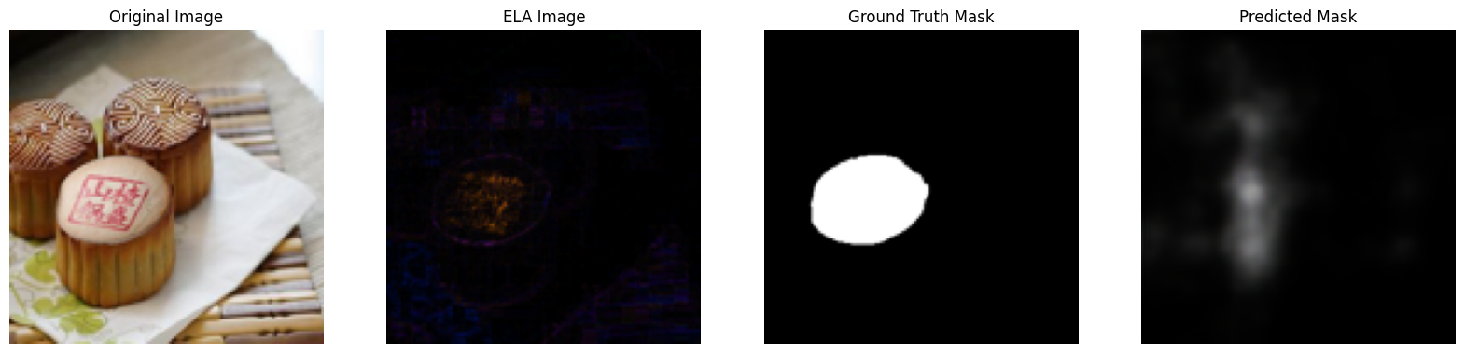
Model Results on Tampered and Real images

Slide 21
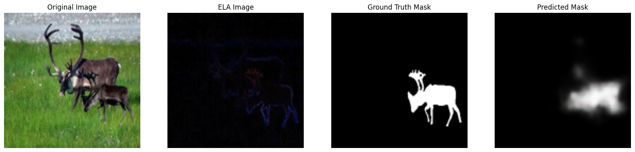
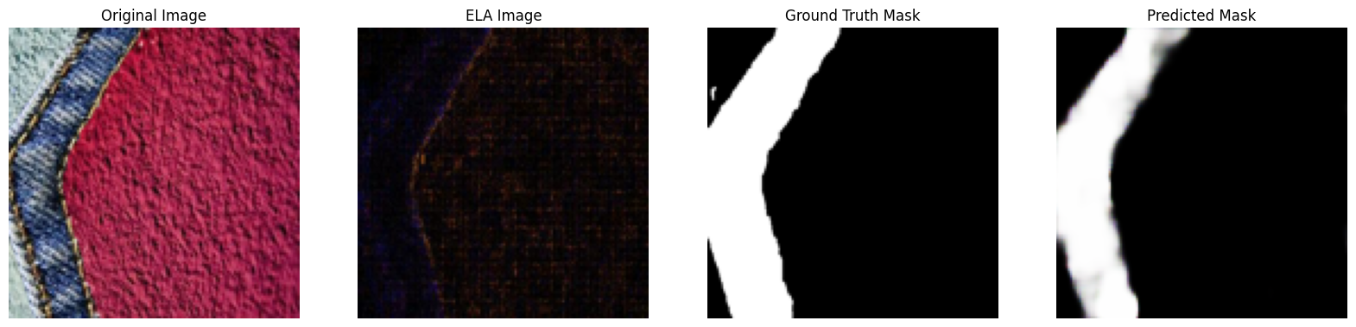
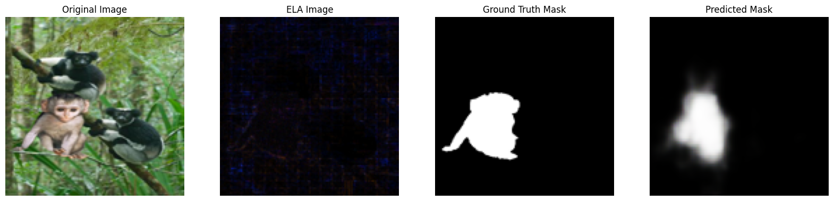
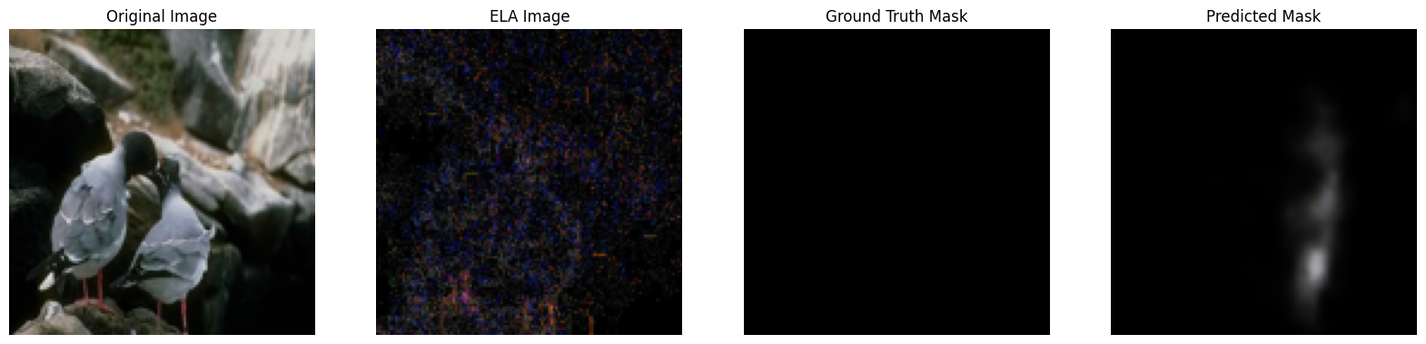

Slide 22
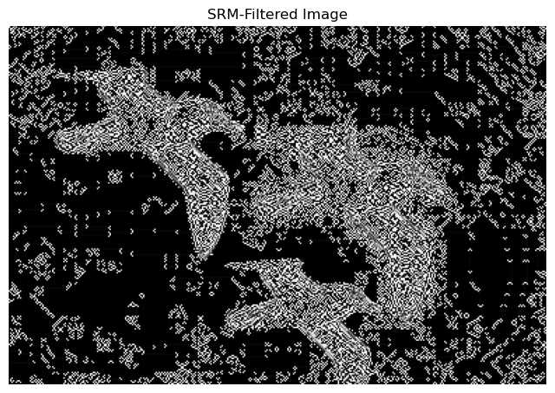
Model 2: Triple Input Model (ELA+SRM)
ELA Performance:
Outperformed UNet in detecting and localizing tampered regions, improving the overall model performance.
Enhancing Model with Additional Input:
To further boost performance, we added an extra input stream to the CNN model called SRM Filters.
SRM Filters:
Identify noise and texture changes from editing, complementing ELA for better forgery detection.
Tampered Image
X2(SRM Image)
Ground Truth Image

Slide 23
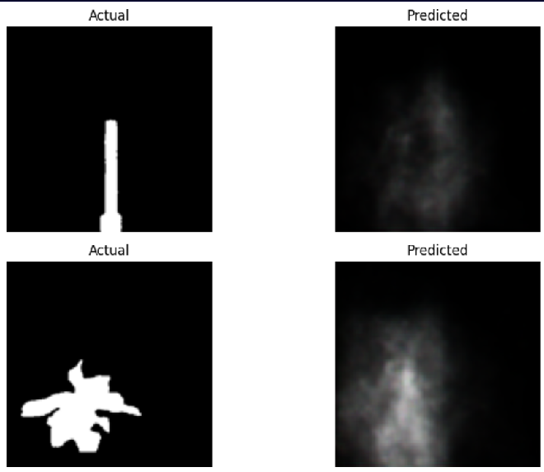
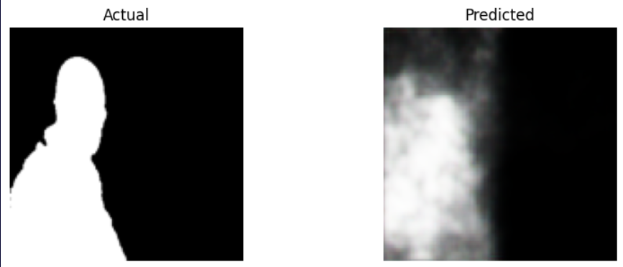
Model 2 Performance
Precision: 0.3832
Recall: 0.2845
F1-Score: 0.3034

Slide 24
Model 3: ELA+CNN+UNET(Reconstruction)
Model 2 Conclusion:
The previous model (ELA + SRM + CNN) showed poor results compared to ELA.
Insight:
SRM filters did not significantly enhance performance when used as an additional input.
Revised Approach:
Integrated U-Net during the reconstruction phase instead of SRM to Investigate whether U-Net improves feature localization and refinement, leading to better overall model performance.

Slide 25
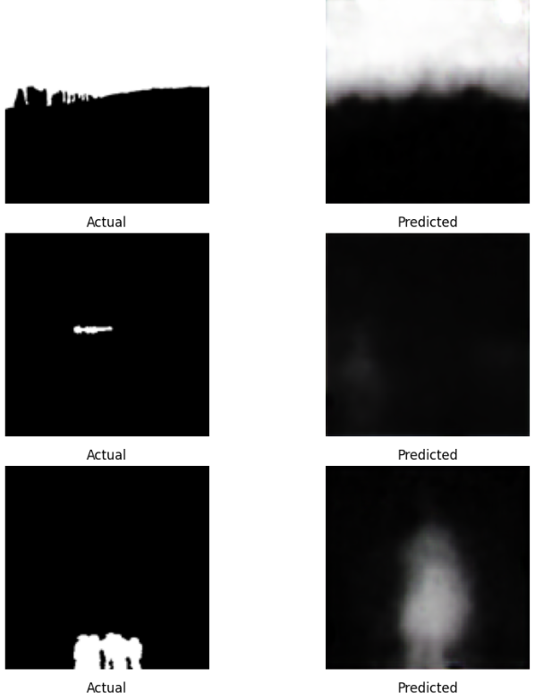
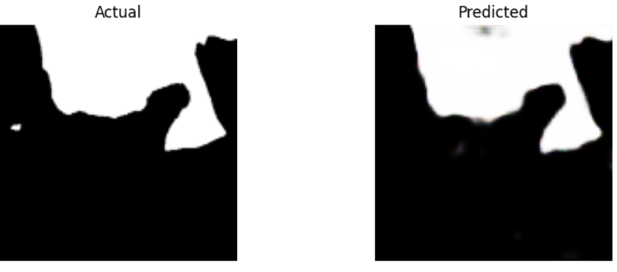
Model 3:Performance
Precision: 0.5161
Recall: 0.3132
F1-Score: 0.3898
Despite using U-Net in the reconstruction phase, the model's performance is still lacking when compared to Model 1 (ELA + CNN), which achieved better results in terms of precision, recall, and F1-score.

Slide 26
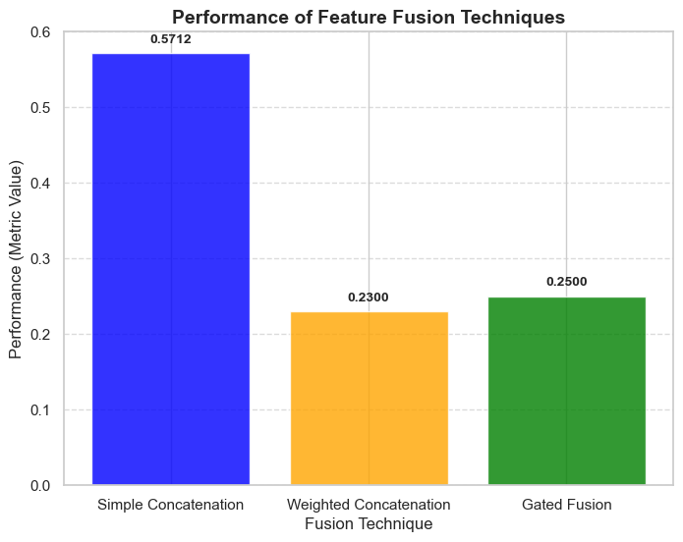
Model 4:Feature Fusion Techniques & Performance
Tried Various Fusion techniques while combing two feature arrays to improve the performance
Feature Array 1: ELA image features (from the ELA image)
Feature Array 2: CNN-extracted features (from the tampered image)
Simple Concatenation: Just Combine the two feature arrays
Weighted Concatenation (Alpha-Beta Fusion):Assign weights (α, β) to each feature array before concatenation.
Gated Fusion: Used a gating mechanism to dynamically adjust feature contributions.
Performance was poor in both cases, compared to traditional concatenation

Slide 27
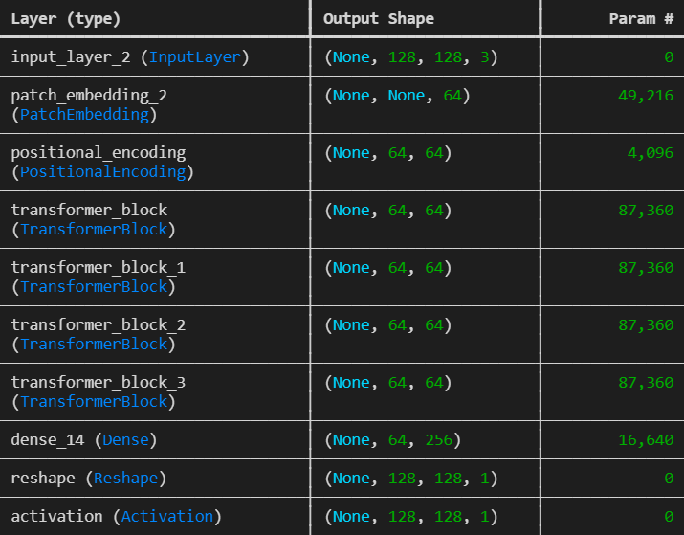
Model 5:Via Vision Transformer – (ViT)
After experimenting with various CNN architectures, we decided to explore Vision Transformers (ViT) to evaluate their performance for our task, as transformers can capture global relationships across the entire image.
Key Steps in ViT Architecture:
Patch Embedding: The input image is divided into 16×16 patches, with each patch embedded into a 64-dimensional vector. This allows the model to process the image as a sequence instead of a grid.
Transformer Blocks: Four Transformer blocks employ multi-head self-attention and MLP layers with residual connections to capture global relationships between the patches.
Positional Encoding: positional embeddings are added to patch embeddings to retain the spatial structure lost during patch extraction.
Output Reshaping: Processed patch embeddings are reshaped into the original image dimensions (single channel) and passed through sigmoid activation for binary classification.

Slide 28
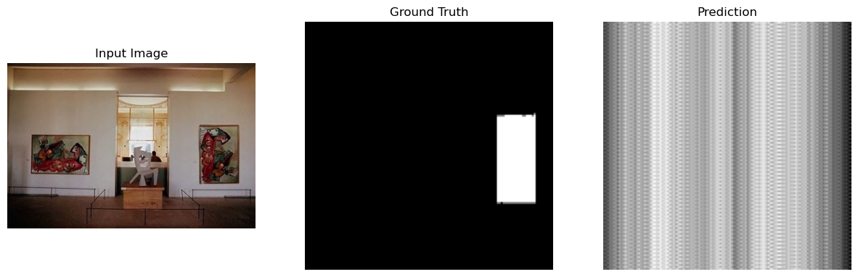
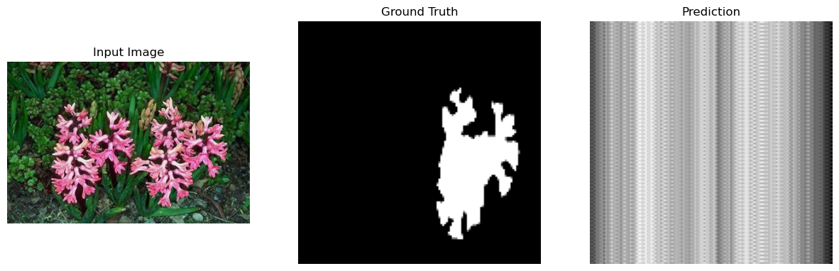
Model 5:ViT Performance
The ViT model underperformed compared to all other models, leading us to conclude that ELA-CNN is the most effective model for region localization.

Slide 29
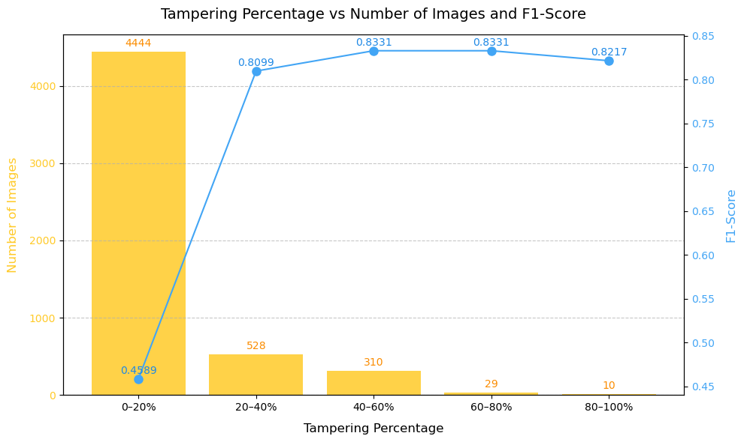
Performance Evaluation of Model 1(ELA+CNN)

Slide 30
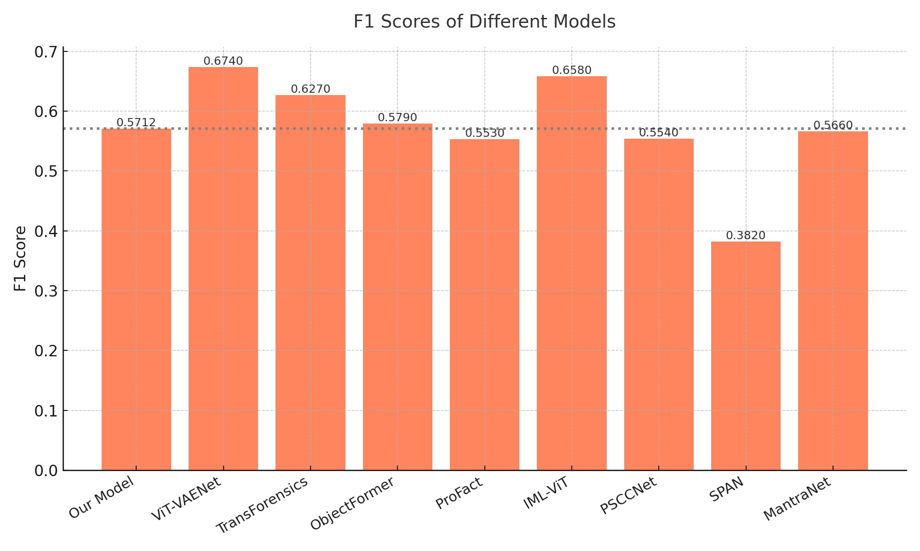
Comparison with State of the Art Models

Slide 31
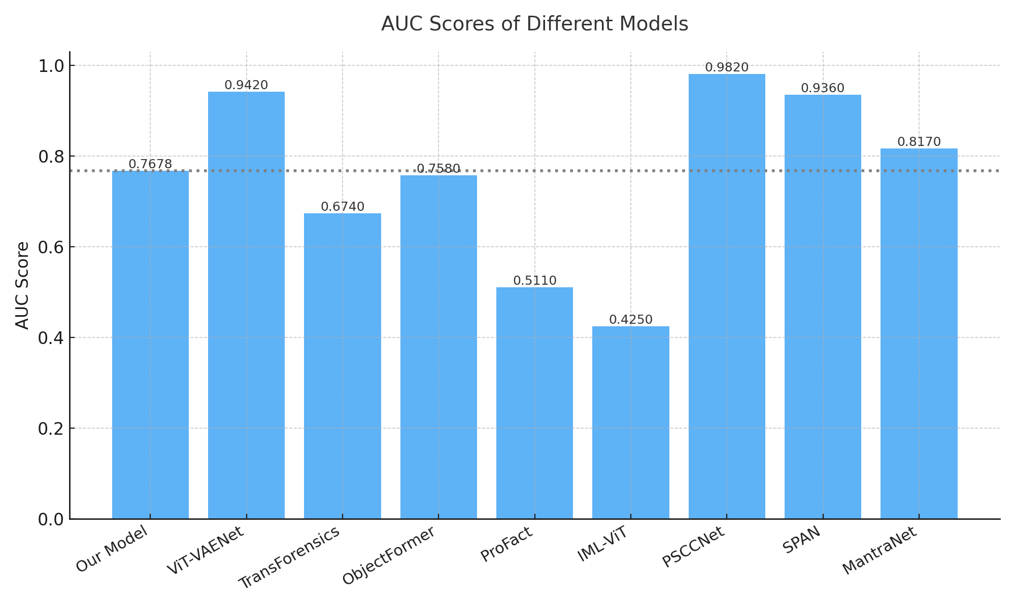
Comparison with State of the Art Models

Slide 32
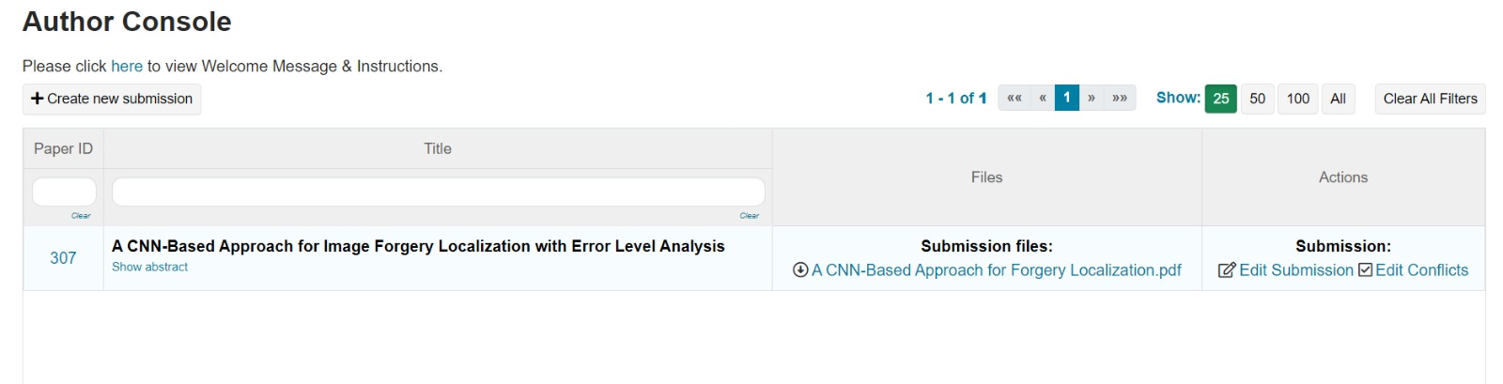
Research Paper Details
Submitted a research paper based on ELA_CNN model to 3rd International Conference on power Engineering and Intelligent Systems (PEIS2025) On 5th January 2025

Slide 33
References
Z. Shi, X. Shen, H. Kang, and Y. Lv, “Image manipulation detection and localization based on the dual-domain convolutional neural networks,” IEEE Access, vol. 6, pp. 76437–76453, 2018.
Y. Wu, W. AbdAlmageed, and P. Natarajan, “Mantra-net: Manipulation tracing network for detection and localization of image forgeries with anomalous features,” in Proceedings of the IEEE/CVF conference on computer vision and pattern recognition, pp. 9543–9552, 2019.
A. M. Nagm, M. M. Moussa, R. Shoitan, A. Ali, M. Mashhour, A. S. Salama, and H. I. AbdulWakel, “Detecting image manipulation with ela-cnn integration: a powerful framework for authenticity verification,” PeerJ Computer Science, vol. 10, p. e2205, 2024.
X. Xia, L. C. Su, S. P. Wang, and X. Y. Li, “Dmff-net: Doublestream multilevel feature fusion network for image forgery localization,” Engineering Applications of Artificial Intelligence, vol. 127, p. 107200, 2024.
A. K. Jaiswal and R. Srivastava, “Fake region identification in an image using deep learning segmentation model,” Multimedia Tools and Applications, vol. 82, no. 25, pp. 38901–38921, 2023.
https://link.springer.com/article/10.1007/s11042-022-13808-w
https://www.forbesindia.com/article/news/the-rise-of-deepfakes-25-percent-of-videos-that-people-watch-are-later-found-to-be-fake/90077/1#google_vignette
https://www.cyber.forum.yale.edu/blog/2021/7/20/deepfake-pornography-beyond-defamation-law

Slide 34
THANK YOU

